Slide 1
Embedded Systems
1 Week Review
Notes:
In today’s class we review the material we covered in the past six classes.

Slide 2
What are Embedded Systems?
Computer
General-Purpose Computer

Slide 3
Computer
Memory
CPU
Program Stored
Fetch
Unit
Execute Unit

Slide 4
General
-Purpose Computer
Computer +Devices +Software
Desktop
Laptop
Server

Slide 5
Embedded System
Has a computer
Not intended general purpose computer

Slide 6
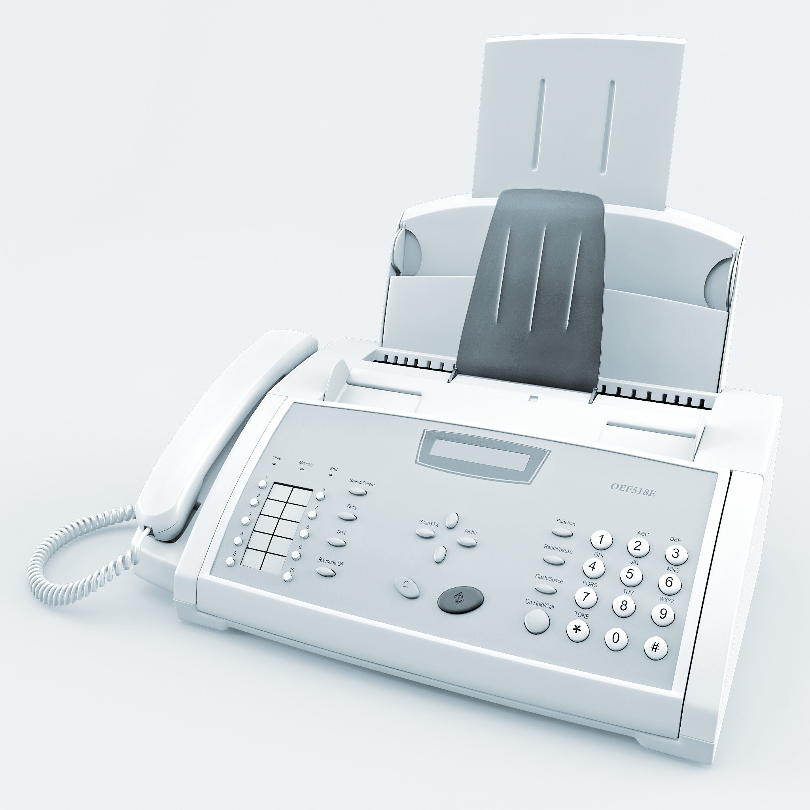
Embedded System
Fax machine

Slide 7
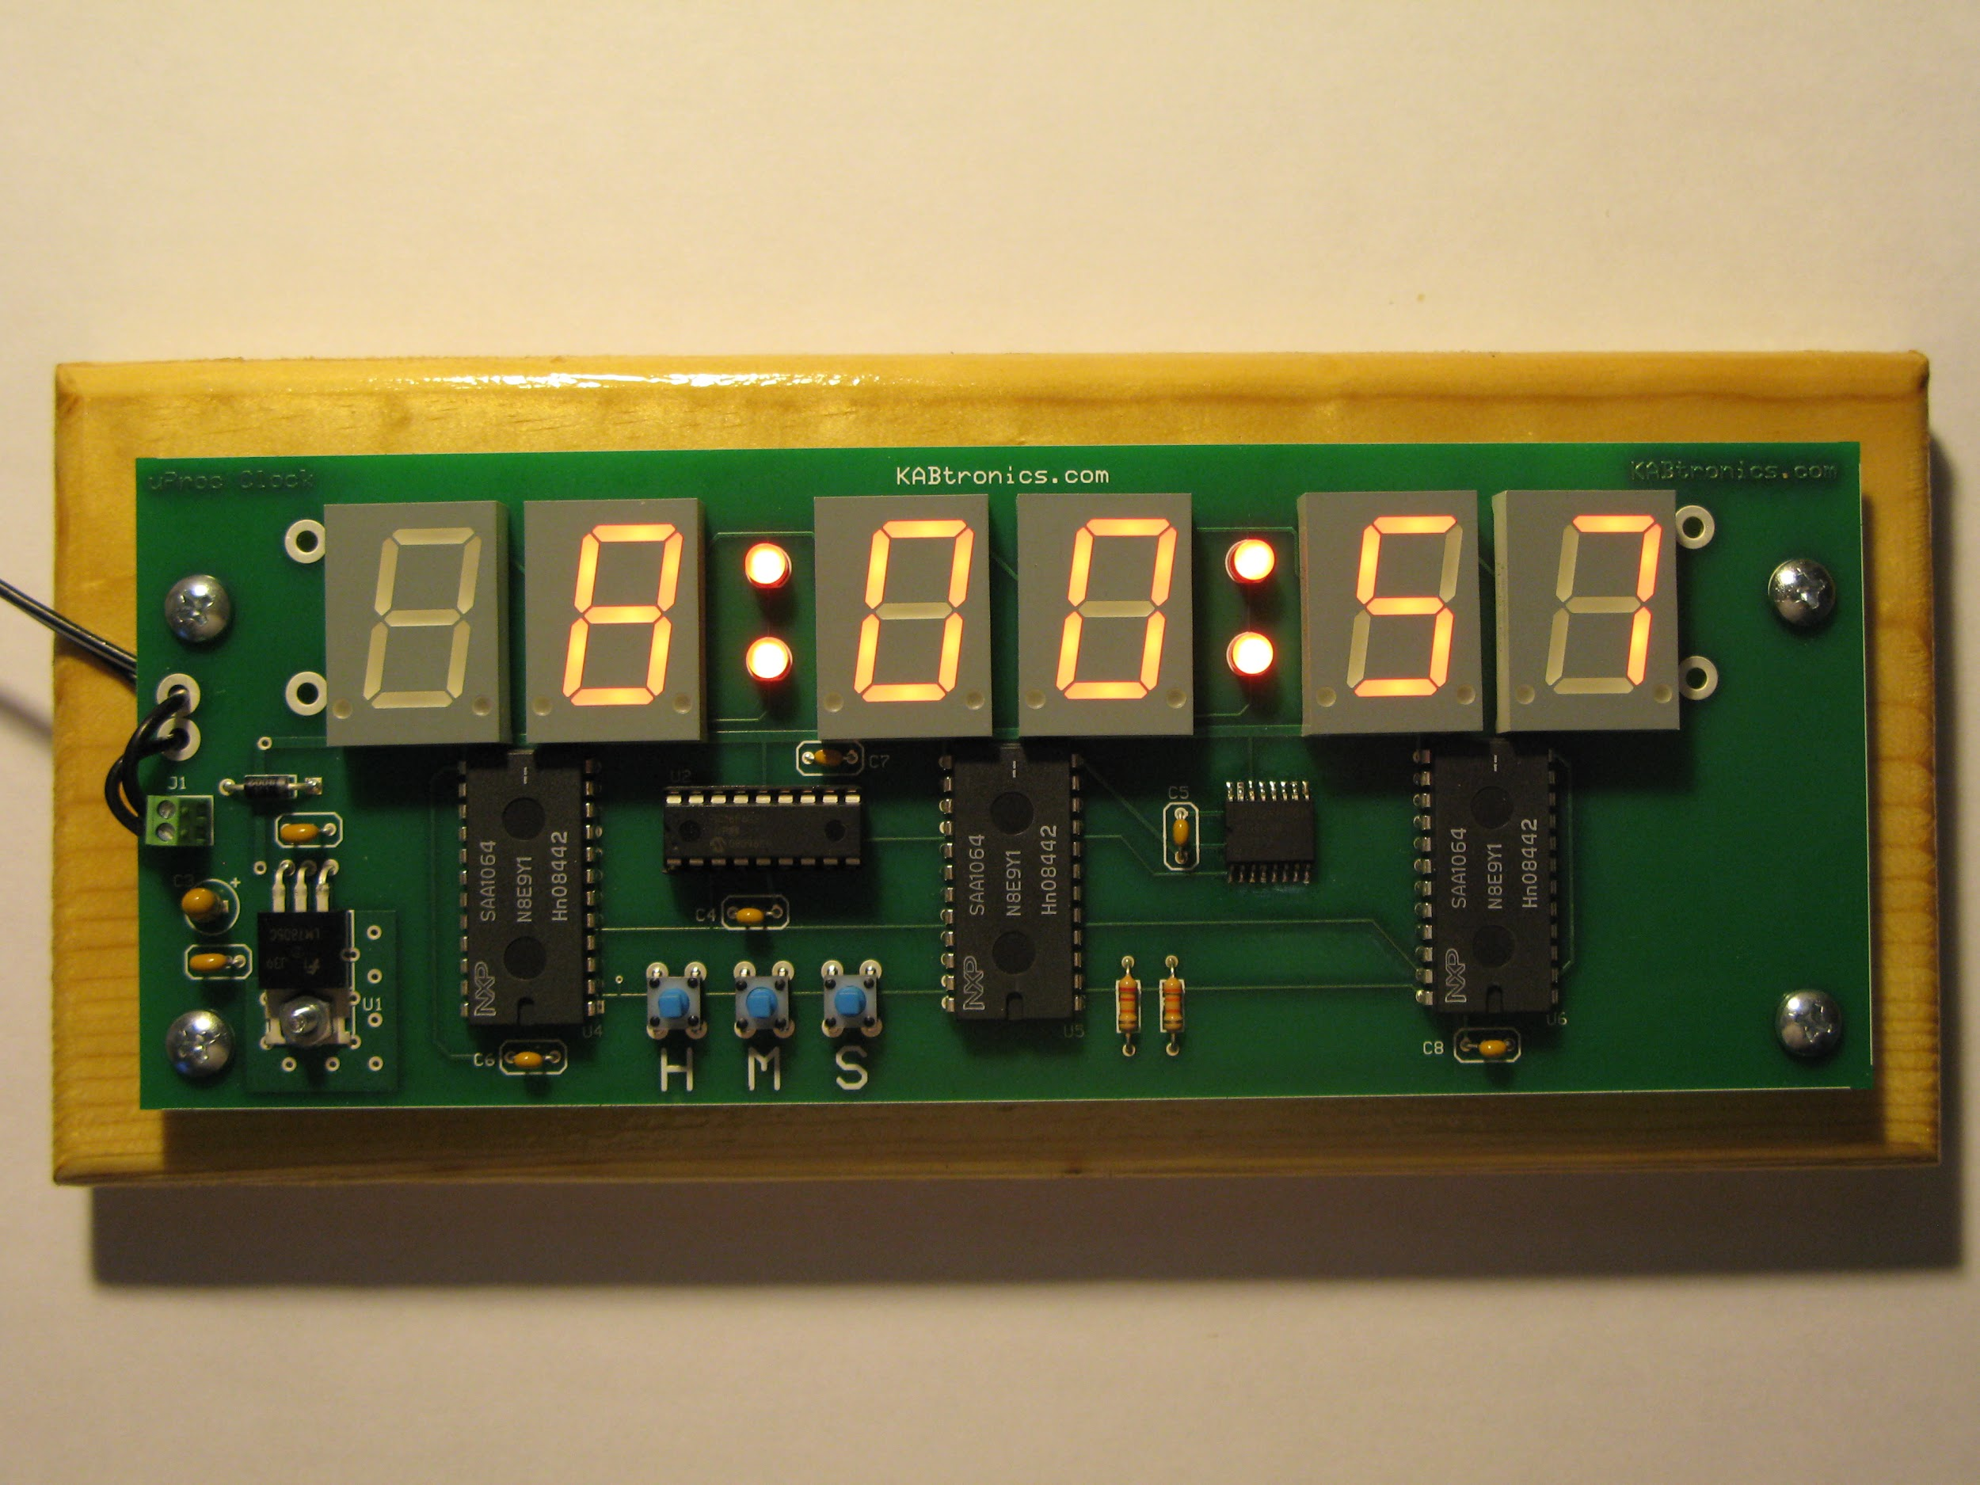
Embedded System
Clock

Slide 8
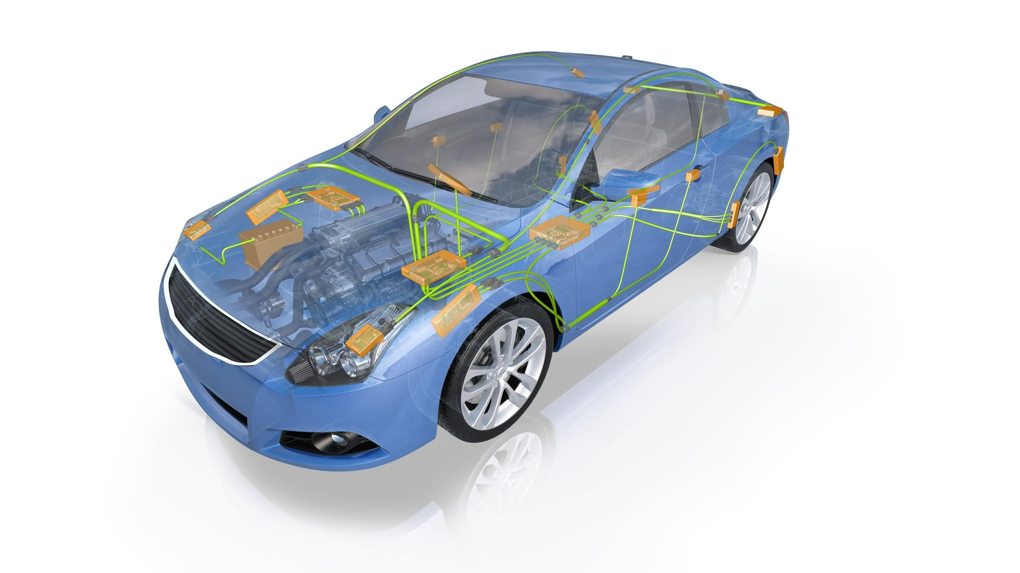
Embedded
System

Slide 9
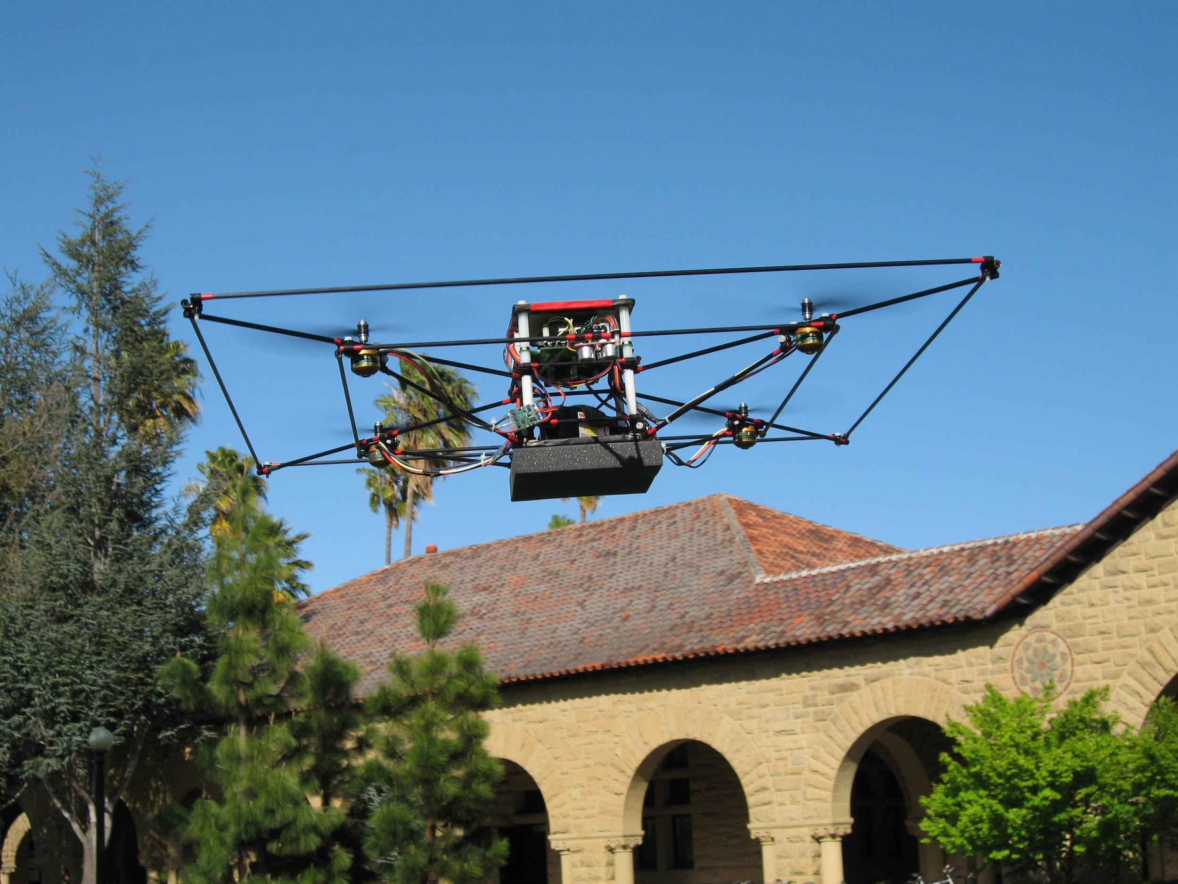
Embedded Systems

Slide 10
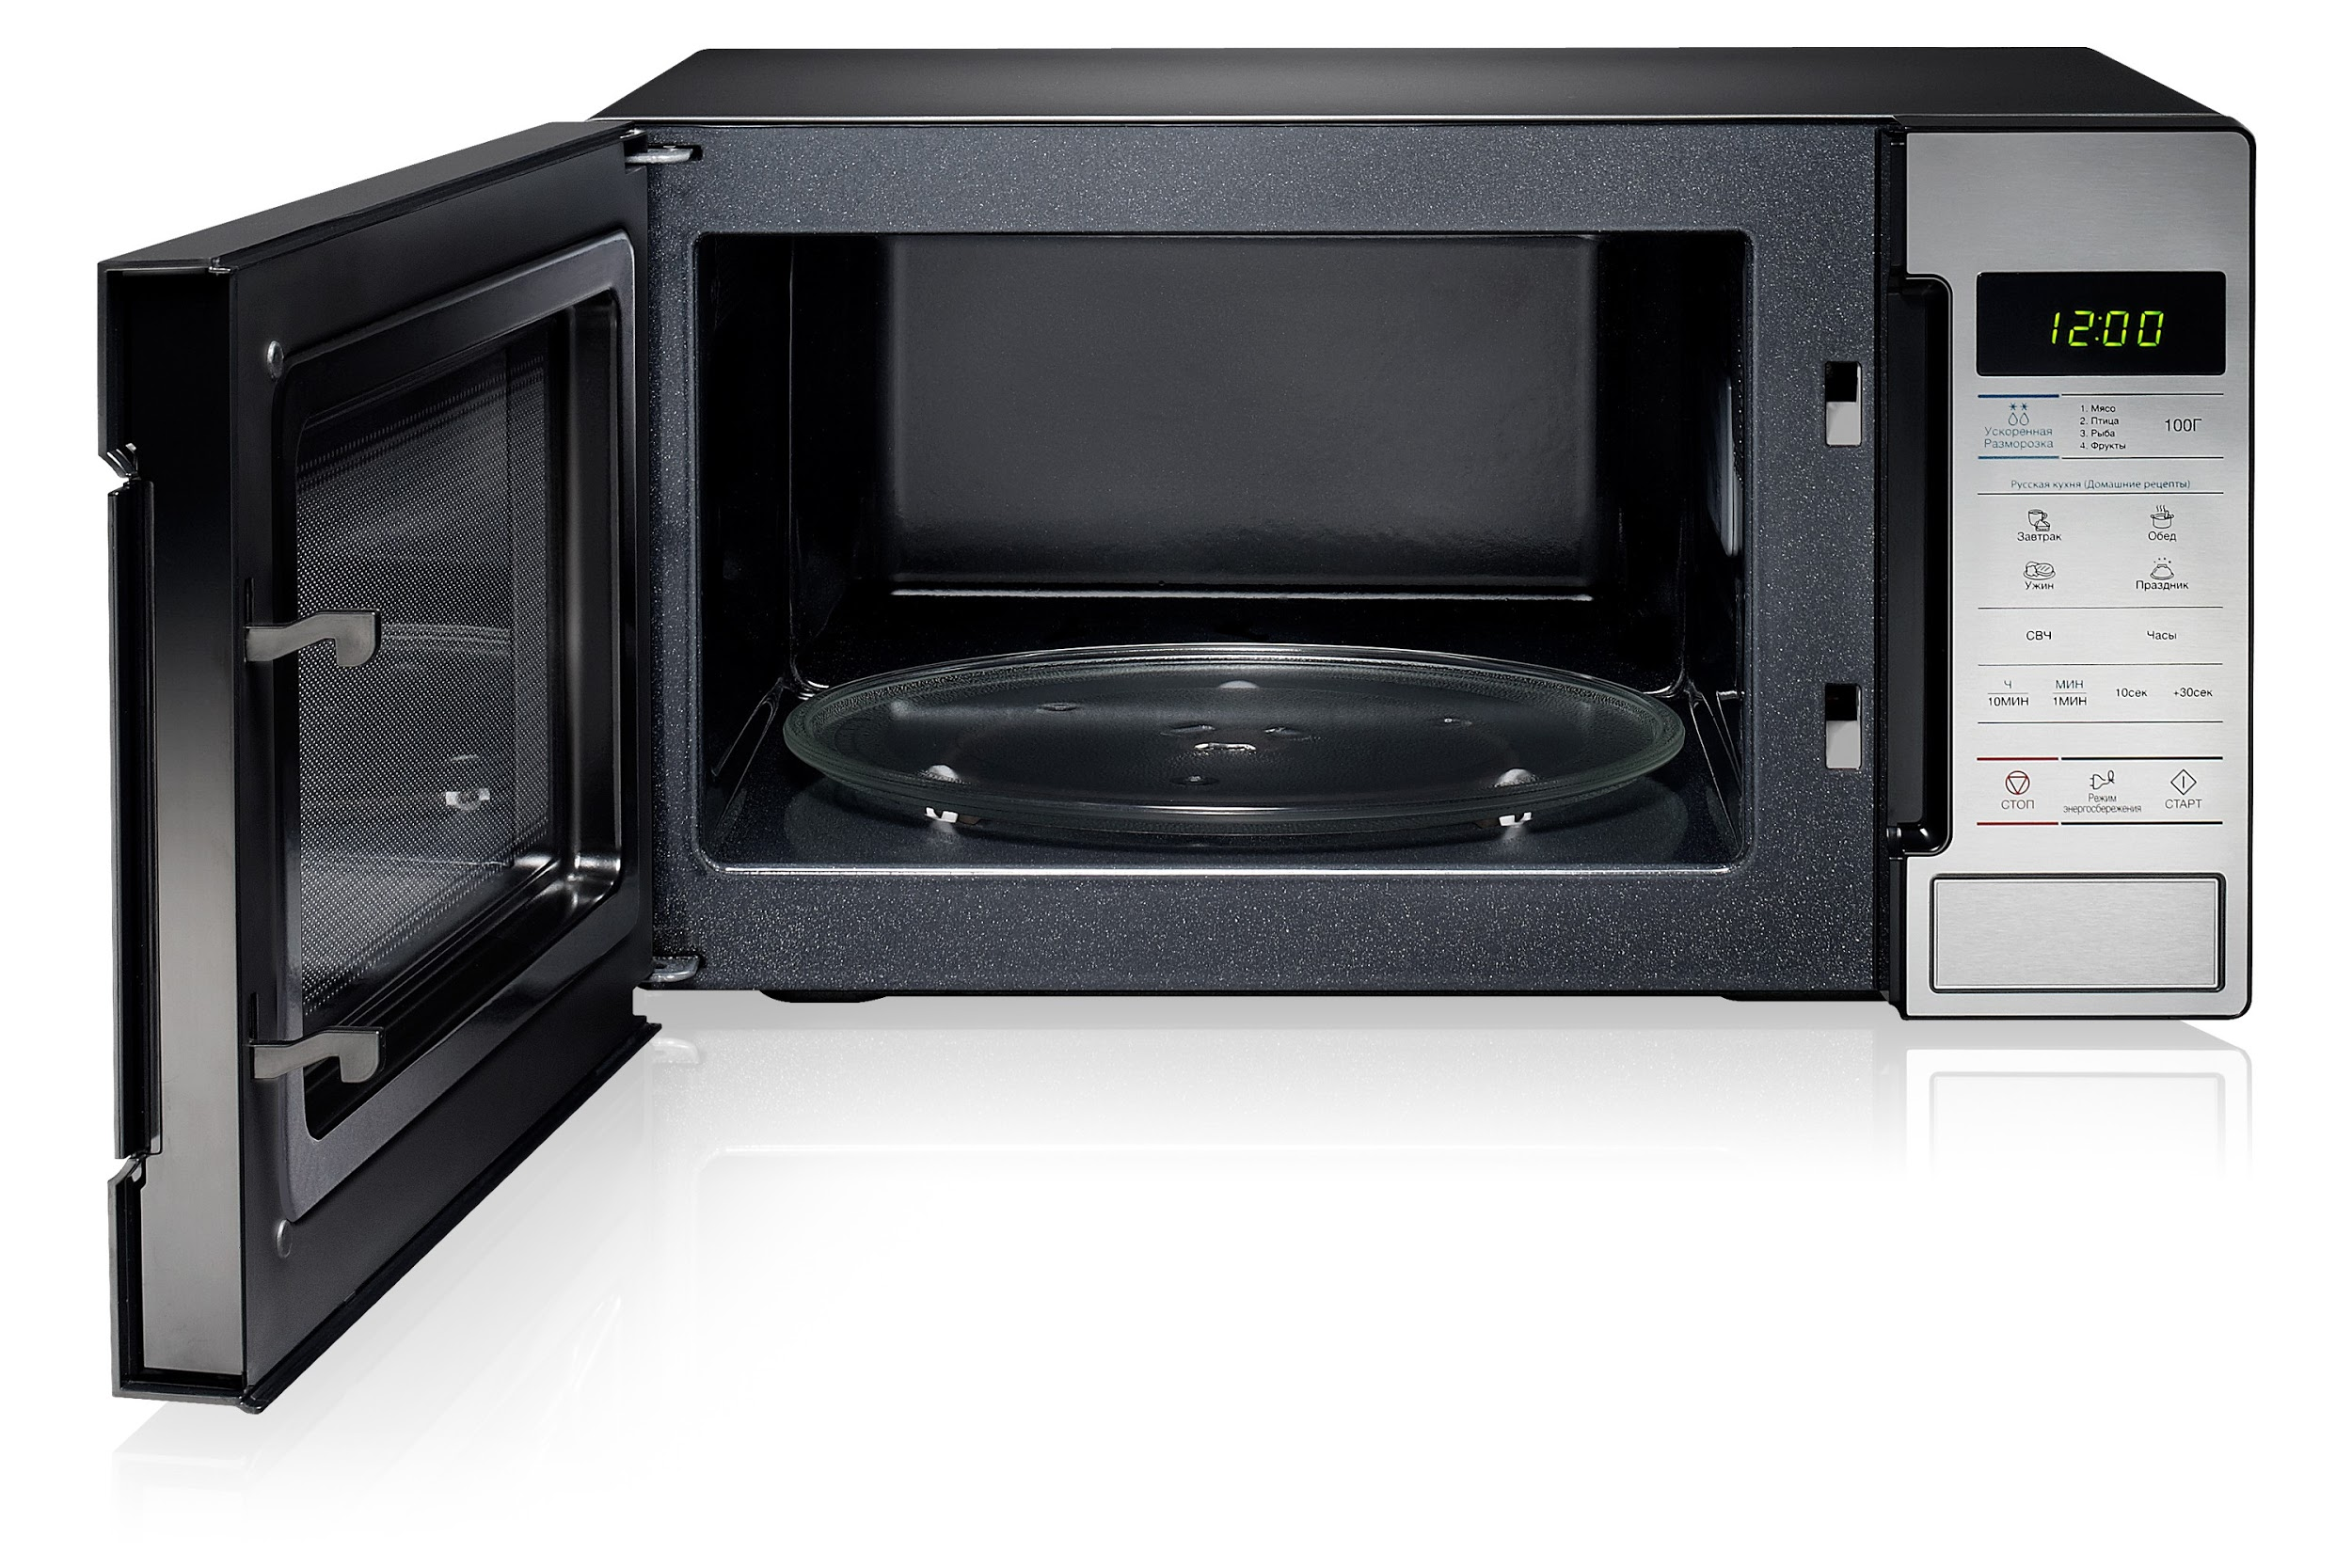
Embedded
System

Slide 11
Embedded System Design
Hardware with I/O devices
Software

Slide 12
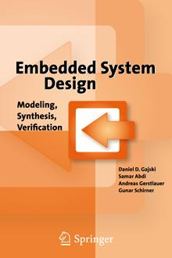

Slide 14
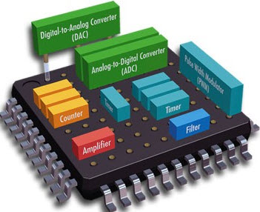
Embedded
System
Design
Electrical
Engineering

Slide 15
Characteristics Emb.Sys
Functionality
Complex Algorithms e.g. Automotive
User Interface e.g. Moving Maps

Slide 16
Characteristics Emb.Sys
2. Deadlines
Real-time
Multirate

Slide 17
Characteristics Emb.Sys
3. Cost
Manufacturing Costs
Power and Energy

